Slide 1




Fresnel holography for radio characterization of meteoroid fragmentation
Joachim Balis, Peter Brown, Hervé Lamy, Emmanuel Jehin
20/09/2024
Contact: joachim.balis@aeronomie.be

Slide 2
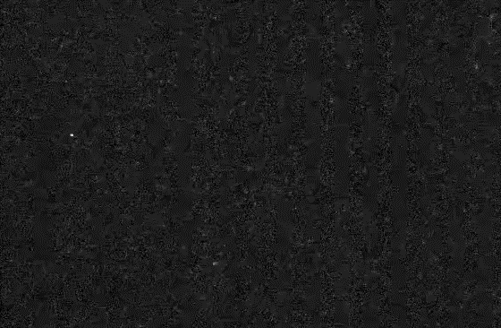

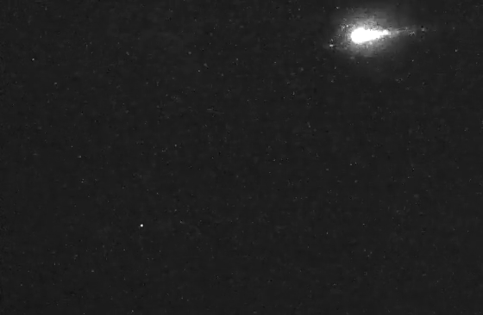
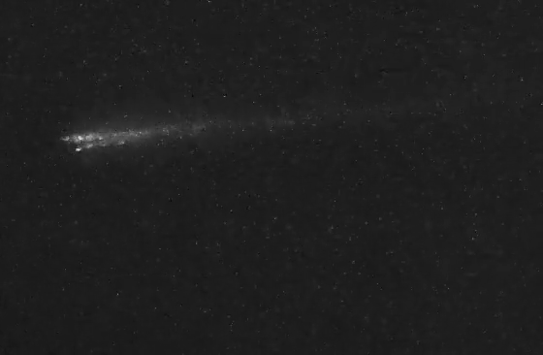
Context
A Geminid 2023 detected by CAMO
Speed 0.5
CAMO = Canadian Automated Meteor Observatory
Event start
Event end
Separation of the meteoroid in two pieces = fragmentation

Slide 3
Context (II)
  We want to better determine the meteoroid:
    Ablation behavior during atmosphere entry
    Dynamics in space
    Strength and composition
    Bulk density estimates
  Small meteoroids are particularly critical for satellites above LEO and for interplanetary travel
  Specifically, the “threat regime” (100 µm – 1 mm) can only be probed with radar
Why do we care about meteoroid fragmentation?
Example of meteoroid structure – Rosetta mission (Guttler et al., 2019)

Slide 4
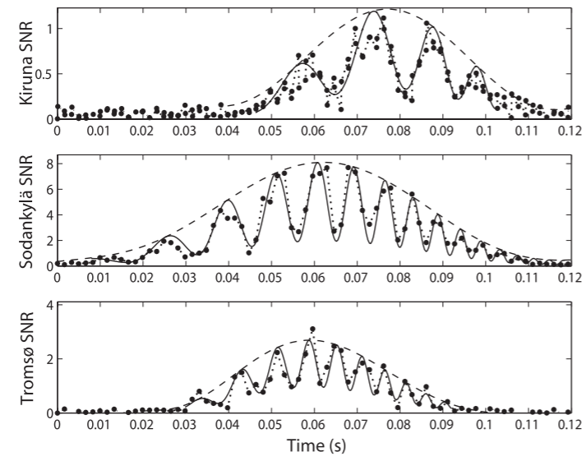
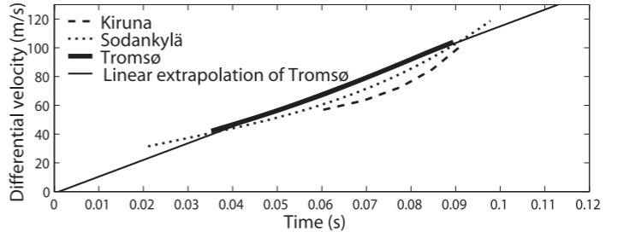
State-of-the-art
How has fragmentation of small meteoroids been studied using radar?
  Literature work has been done through head echoes
  Most convincing evidence was obtained with tristatic measurements (Kero et al., 2008):
Power profiles at 3 receivers
Beating analysis
Velocity between fragments

Slide 5
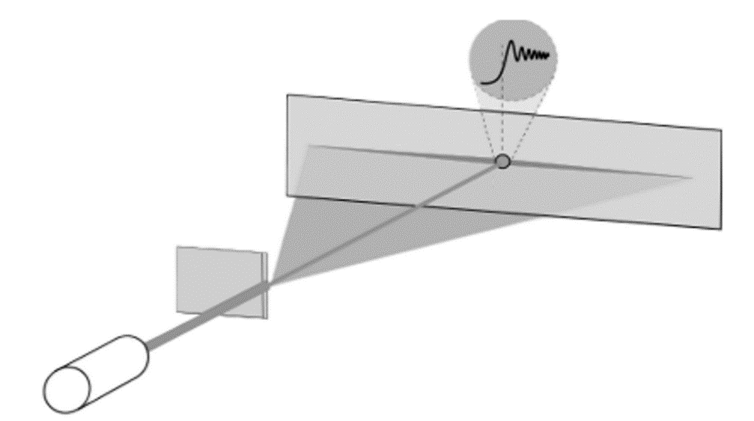
Fresnel Transform (FT)
The Fresnel Transform is a potentially powerful tool for characterizing fragmentation with trail echoes
The optical analogue is the light curve computed from a diffraction pattern
    Diffraction pattern around a knife edge radio amplitude fluctuations
Diffraction pattern
    FT = inversion of this pattern, i.e., source behavior:
      Optical light curve
      Radio ionization curve
Knife edge
Light source

Slide 6
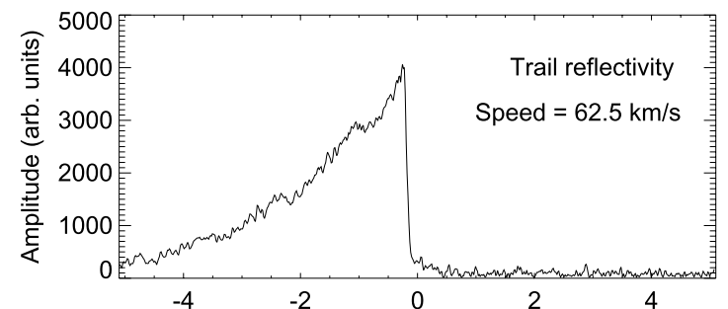
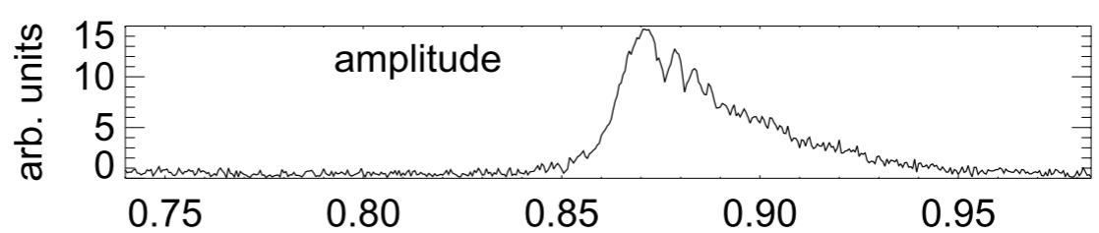
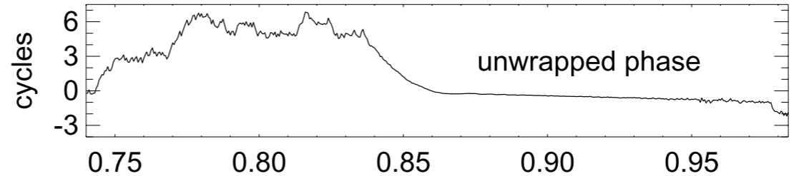
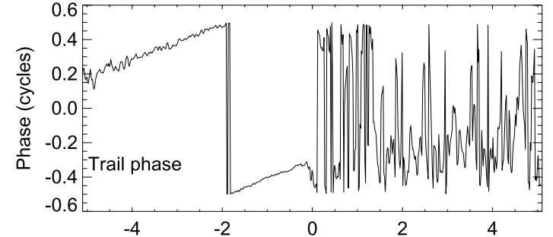
Our approach
Develop an open-source Python package for systematically characterizing meteoroid fragmentation with the Fresnel Transform
Ionization curves
?
Time-domain signal
Fragmentation
Fresnel Transform
Behind meteoroid
In front of meteoroid
Time [s]
Pictures taken from Elford (2004)
Distance along trail [km]

Slide 7
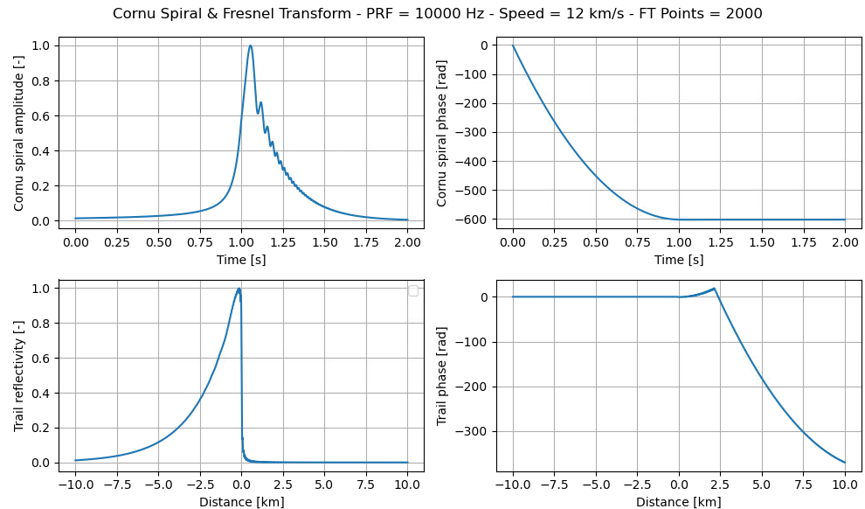
Software development
Exponential -> temperature
Sharpness -> meteoroid speed
Phase -> wind drift

Slide 8
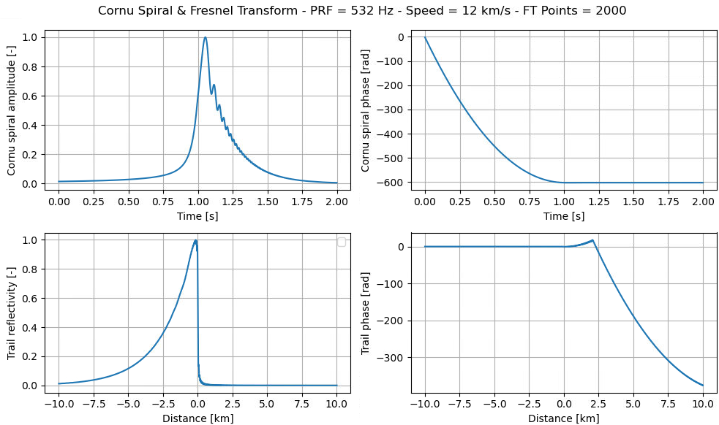
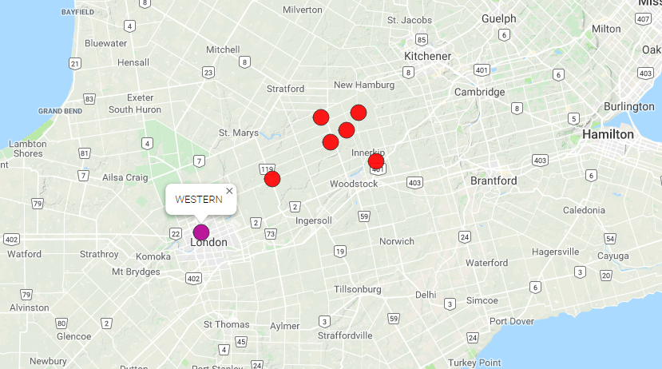
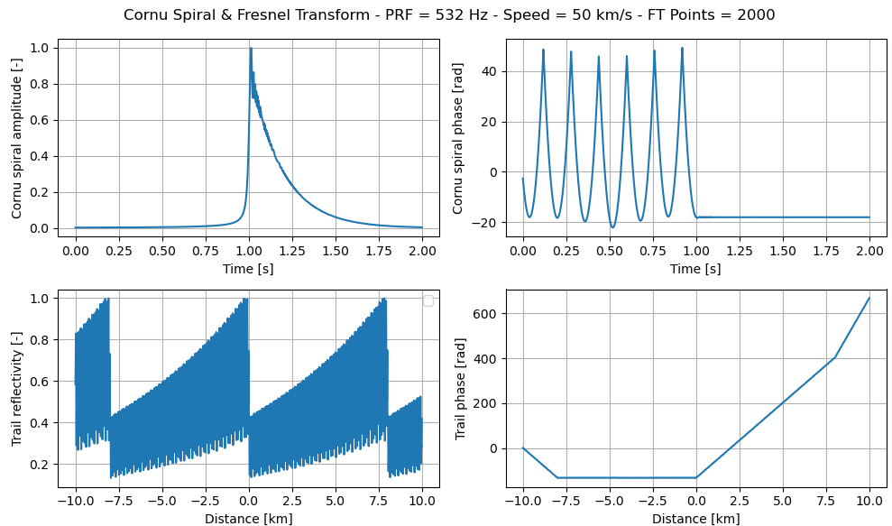
Aliasing challenge
  A 3-frequency radar (blue circle)
f = 17, 29 & 38 MHz
P = 15 kW
PRF = 532 Hz
6 receiving stations (blue + green circles)
CMOR = Canadian Meteor Orbit Radar
PRF = 532 Hz
v = 12 km/s
PRF = 532 Hz
v = 50 km/s

Slide 9
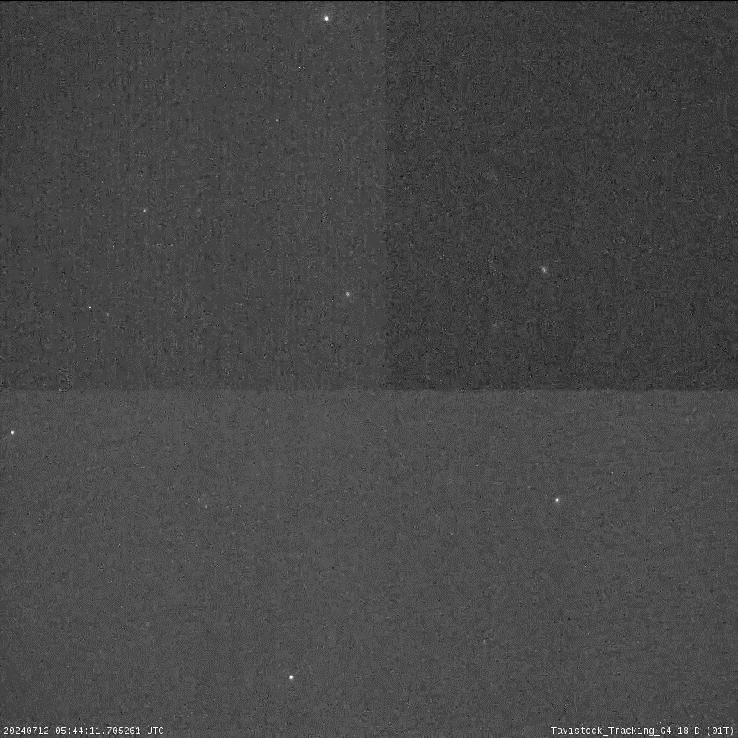
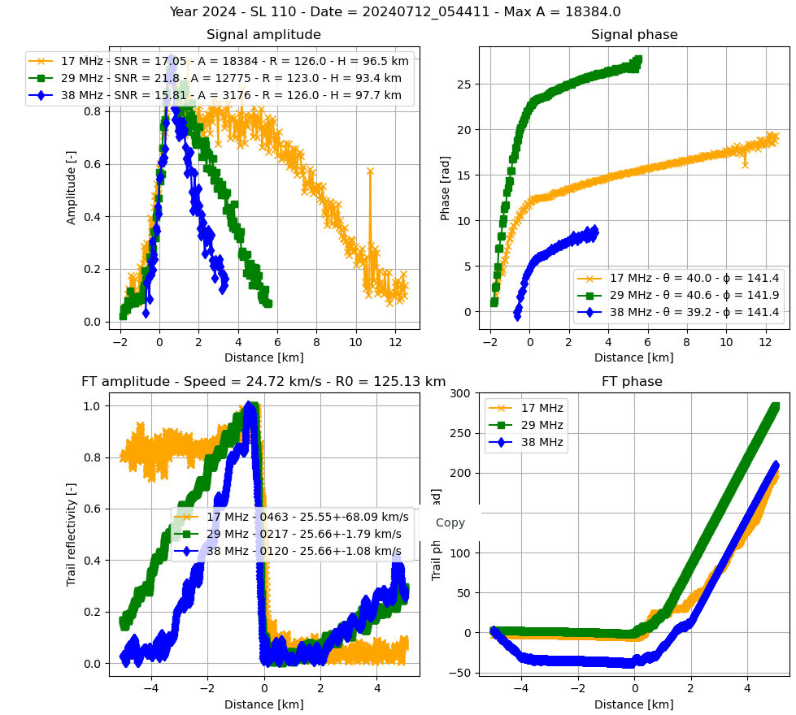
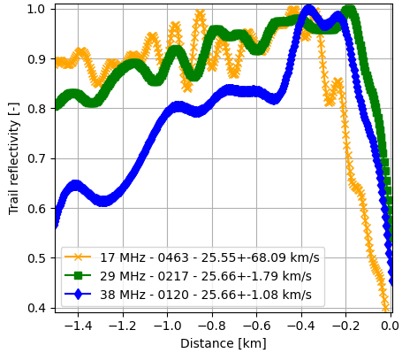
Study of 3-frequency events
CAMO record
Fresnel Transform
Zoom on Fresnel Transform
200 m
v = 24.7 km/s
H = 96 – 91 km
m ~ 70 mg
200 m
= Local peak at 38 MHz

Slide 10
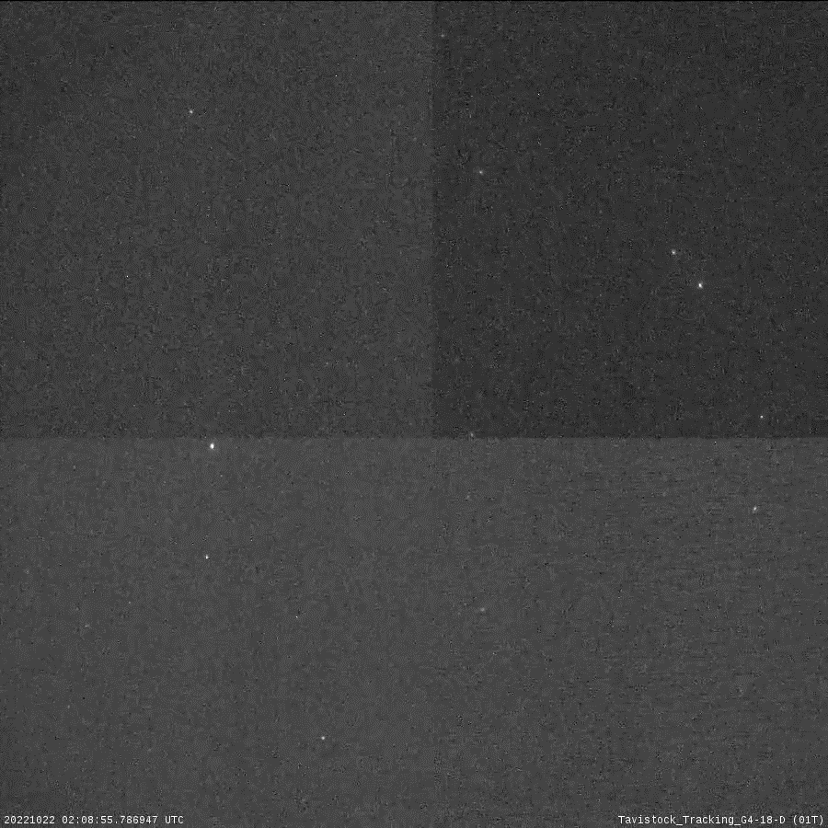
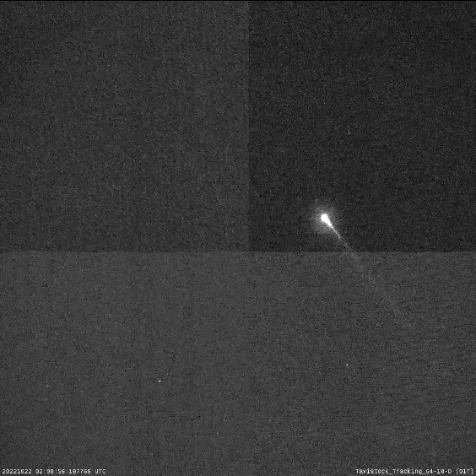
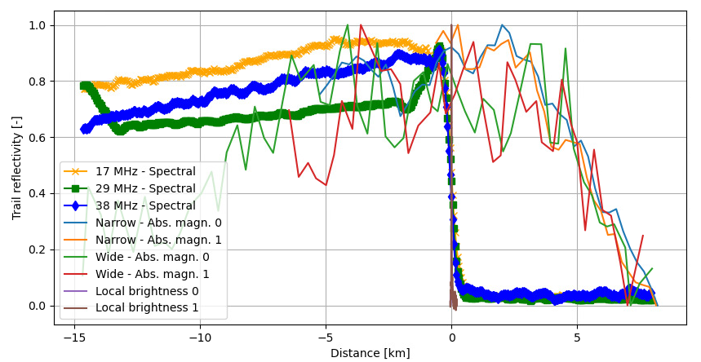
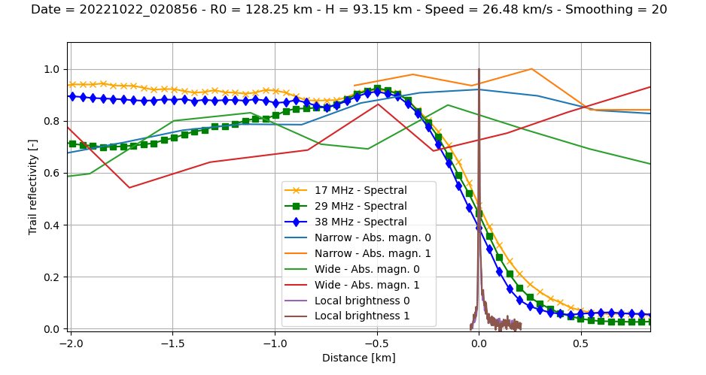
Optical comparison
  1) Light curve of the whole optical record
  2) Local trail brightness
500 m
500 m
v = 28.6 km/s
H = 99 – 90 km
m ~ 100 mg
Comparison radar-optical
Zoom
500 m

Slide 11
Conclusions & Perspectives
The ionization behaviour appears to be frequency-dependent
There is no clear match with the light curve – the Fresnel Transform looks at a different length scale (2-3 km)
The caveat is the low PRF which triggers aliasing for almost every echo
Tests at higher PRF (2142 Hz) are currently being run
The Fresnel Transform is a powerful tool to determine meteoroid speed, compute atmospheric temperatures and wind speeds

Slide 12
Thank you for listening!

Slide 13
References
Güttler C. et al. (2019). Synthesis of the morphological description of cometary dust at comet 67P/Churyumov-Gerasimenko. Astronomy & Astrophysics, 630, A24. https://doi.org/10.1051/0004-6361/201834751
Verbeeck C. & Wislez J-M. (2005). Proceedings of the Radio Meteor School 2005. International Meteor Organization, Oostmalle, 10-14 September.
Kero, J., Szasz, C., Pellinen-Wannberg, A., Wannberg, G., Westman, A., Meisel, D.. (2008). Three-dimensional radar observation of a submillimeter meteoroid fragmentation. Geophysical Research Letters, 350(4). https://doi.org/10.1029/2007GL032733
Elford W. G. (2001). Radar observations of meteor trails, and their interpretation using fresnel holography: A new tool in meteor science. Atmospheric Chemistry and Physics Discussions, 4:911–921. https://doi.org/10.5194/acp-4-911-2004
Holdsworth D. A., Elford W. G., Vincent R. A., Reid I. M., Murphy D. J., Singer W. (2007). All-sky interferometric meteor radar meteoroid speed estimation using the Fresnel transform. Annales Geophysicae, 25(2), 385–398. https://doi.org/10.5194/angeo-25-385-2007

